Slide 1
AUTOMATONUS Presented By: Shruti Bindal(191500791) Yashika Gupta(191500939)

Slide 2
OUTLINE
About the Project
Objectives
Requirements
Snapshots of the website

Slide 3
About the Project
Landing screen: The first page is landing page where you can navigate to home page, contact us and about page.
Main page: It will contain four choices from which user can select on which to work upon.
Background alteration: In this user can upload foreground green screen image which he/she can change into their preferable background and can apply filters according to their likings.
.

Slide 4
OCR(IMG to PDF): OCR stands for "Optical Character Recognition." It is a technology that recognizes text within a digital image. It is commonly used to recognize text in scanned documents and images.
Text-to-Speech: It will convert text written to speech.

Slide 5
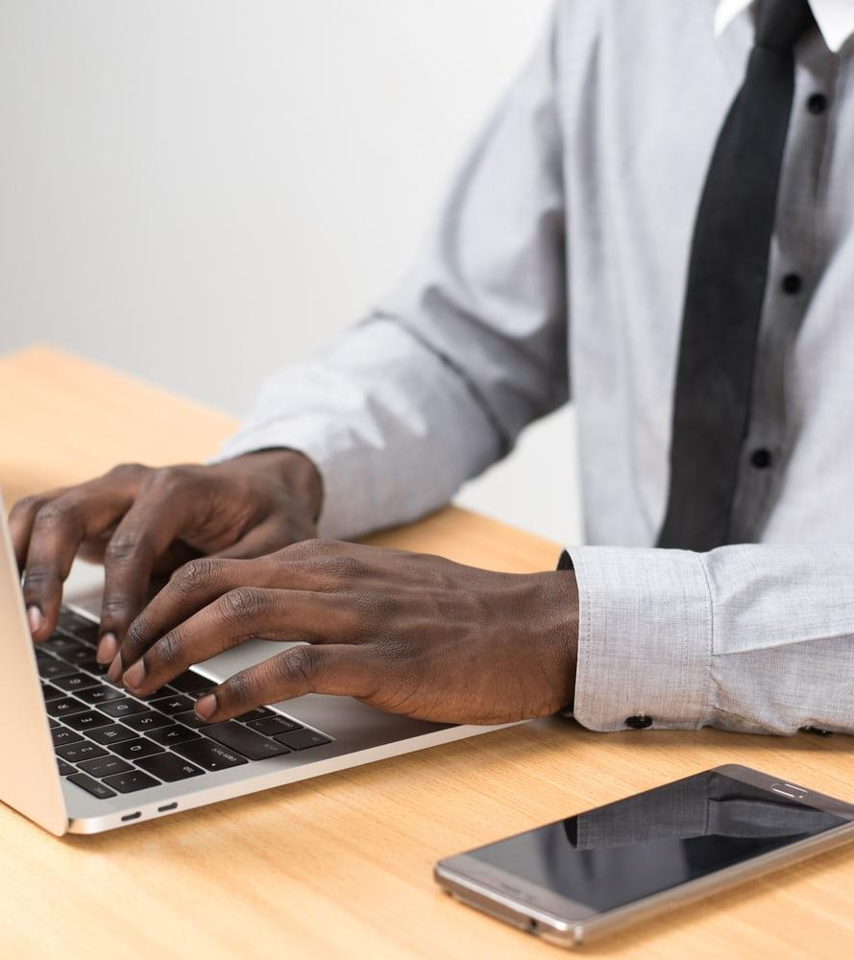
Objective
Our Objective is to design and create a platform from where users can access the features of Green Screen background change , Secondly we are going to add the feature of filter choosing on the uploaded image , then there will be Optical Character Recognition (OCR) ,i.e the text in image will be converted to pdf , then there will be speech recognition.

Slide 6
Requirements
Software Requirements
Windows/Linux Operating System
Visual Studio Code
Programming Languages
JavaScript
HTML5
CSS3

Slide 7
Hardware Requirements
Computer System with minimum 8GB of RAM
Web Browsers – Google Chrome, Microsoft Edge or any other web browser
Note -: older browsers may not support some features of the HTML5 and CSS3

Slide 8
The Look of the Website :-

Slide 9
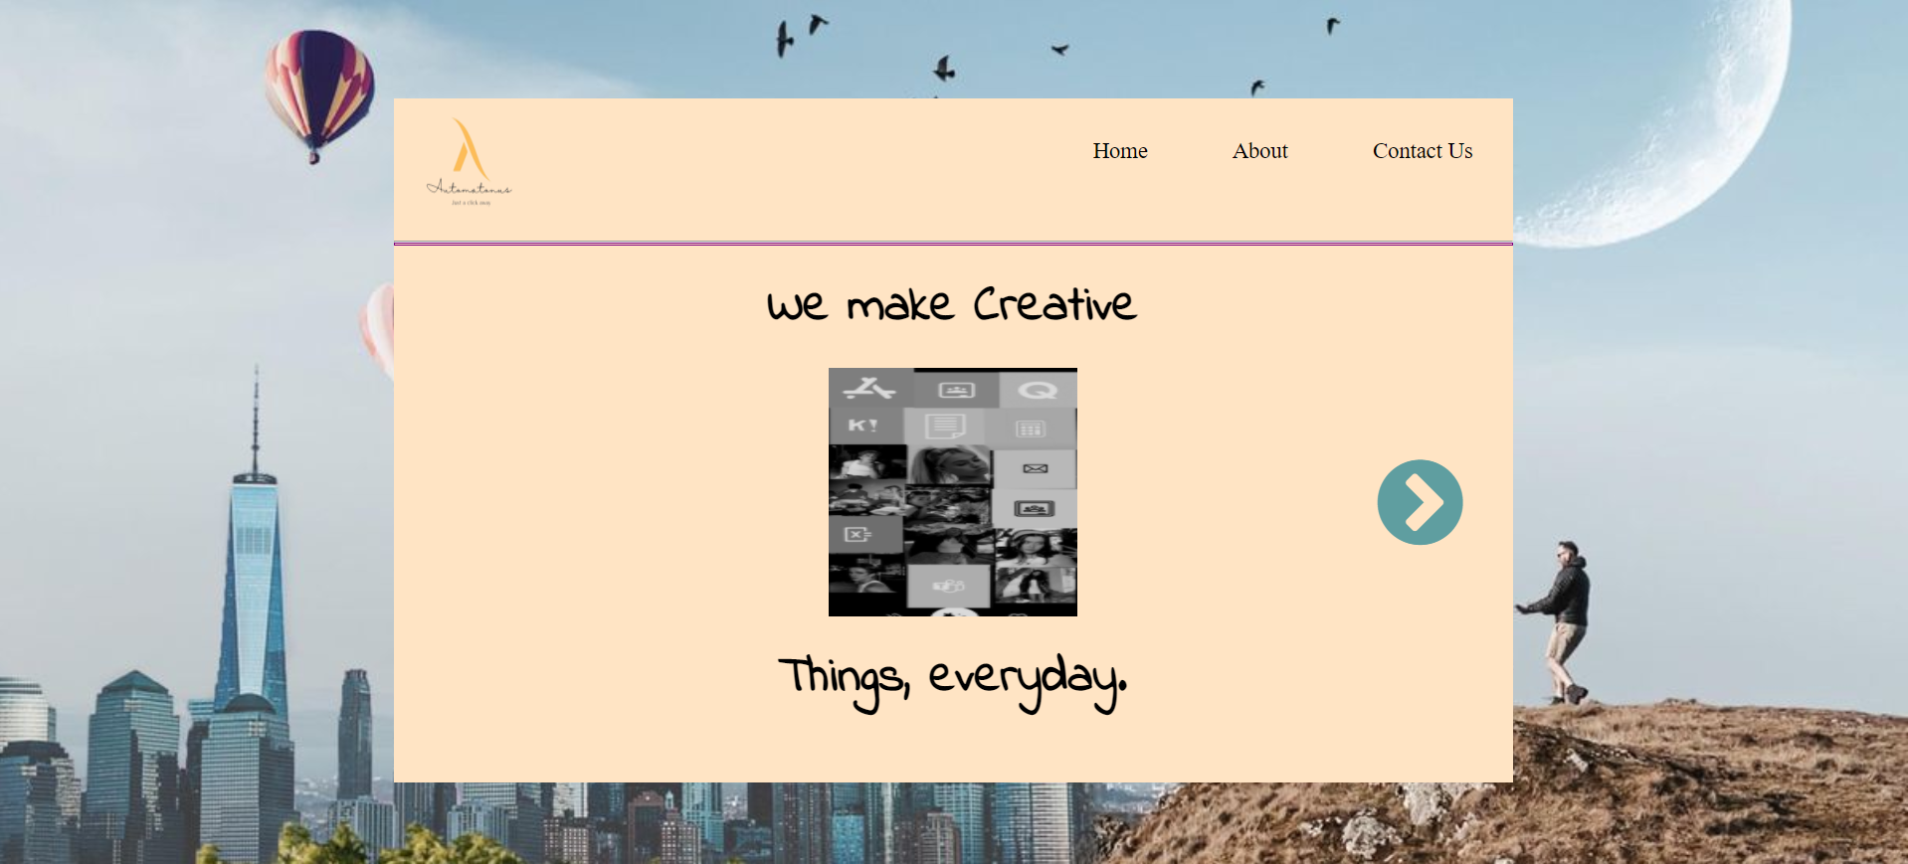
1. Landing Page
This is a Landing page of a website from where we can navigate to Home page, About And contact page.

Slide 10
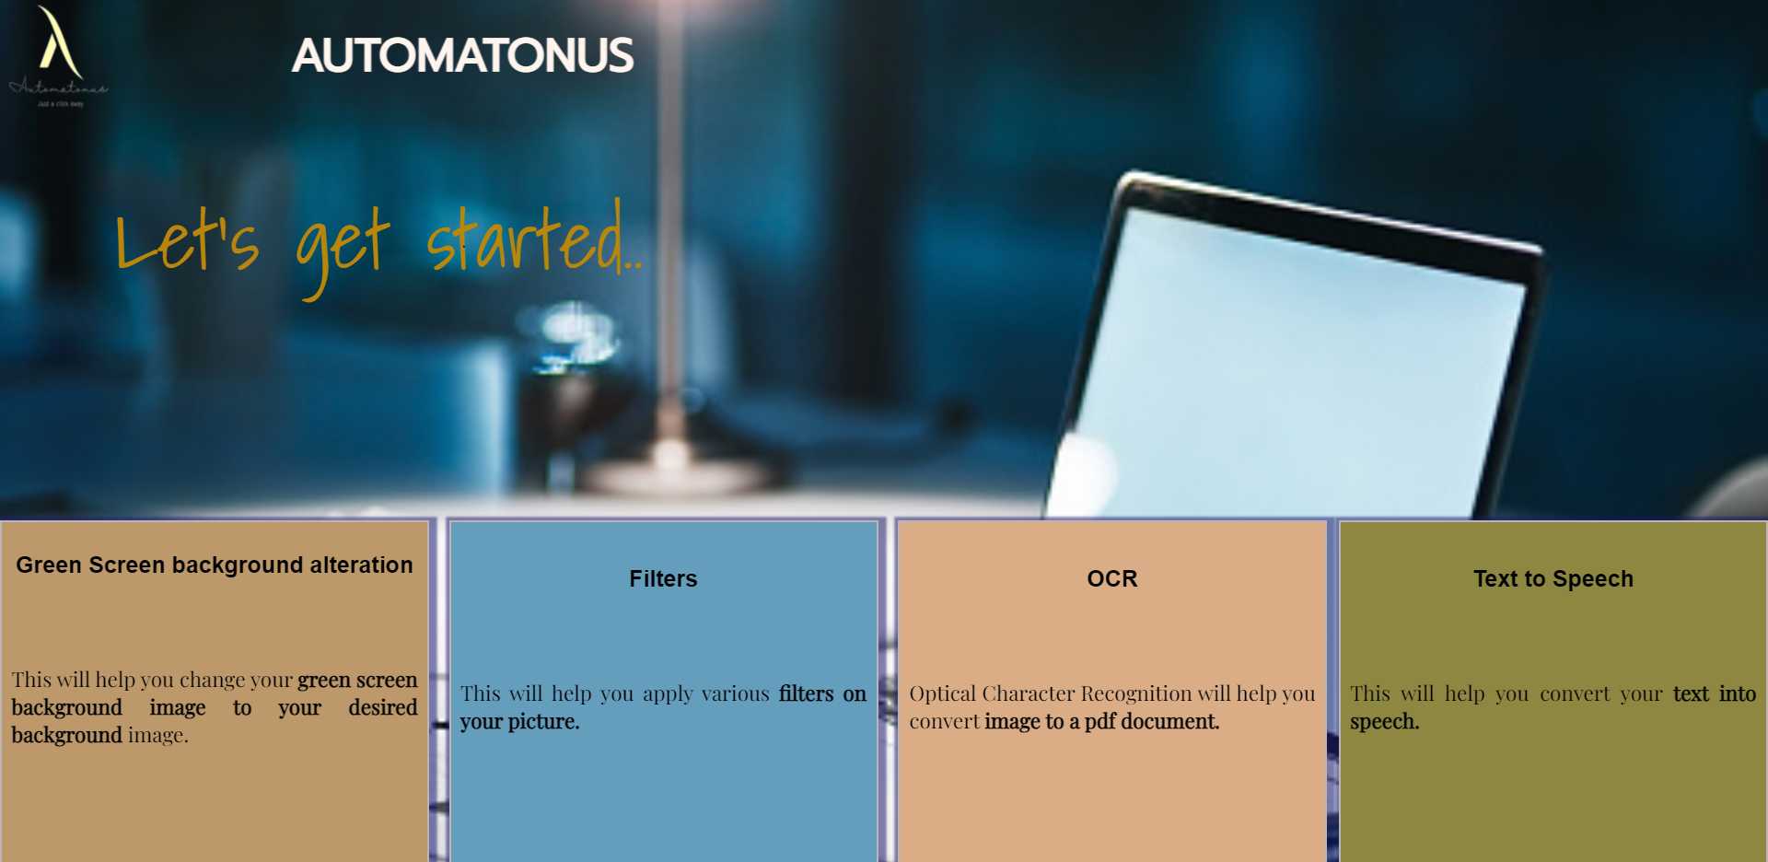
2. Home
This is a Home page which contains four options by which we can navigate on other pages.

Slide 11
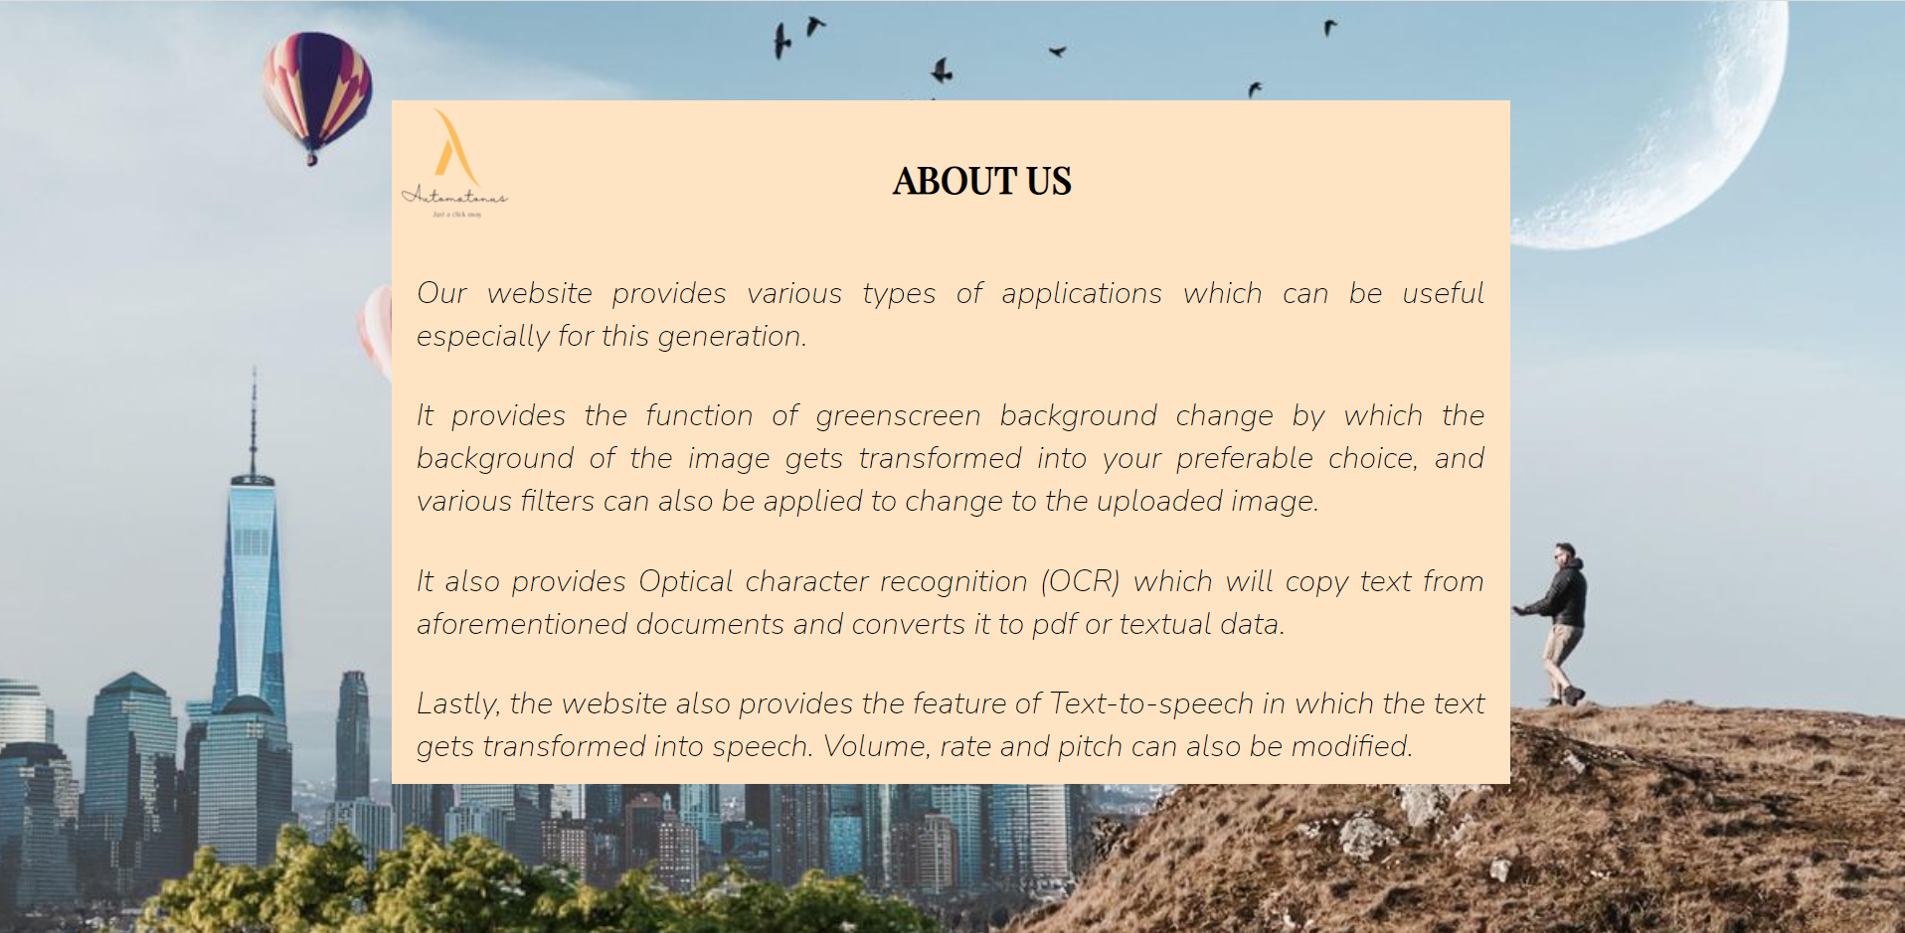
3. About
About page will contain that what are website is all about.

Slide 12
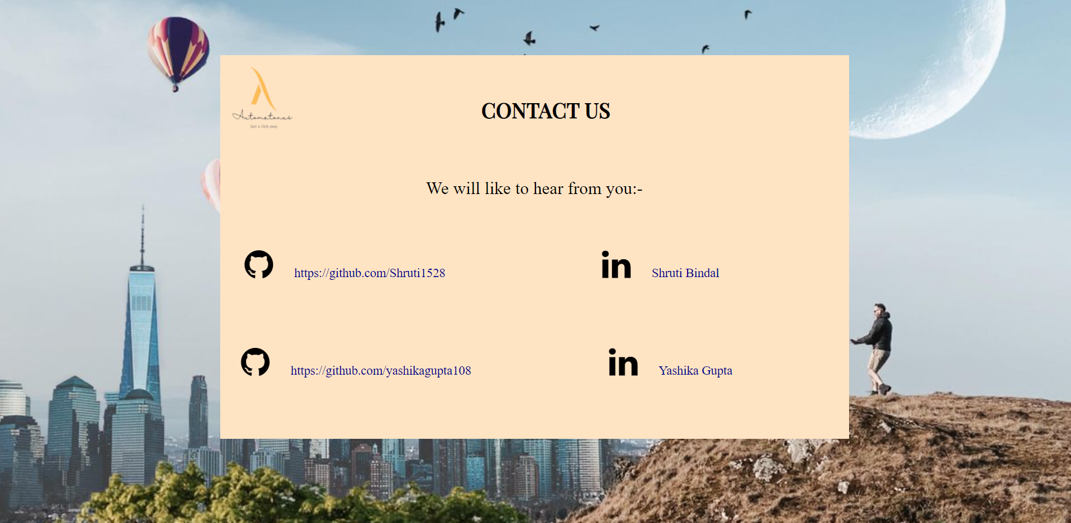
4. Contact
This page will contain the gmail and linkedin IDs of the developers of the website.

Slide 13
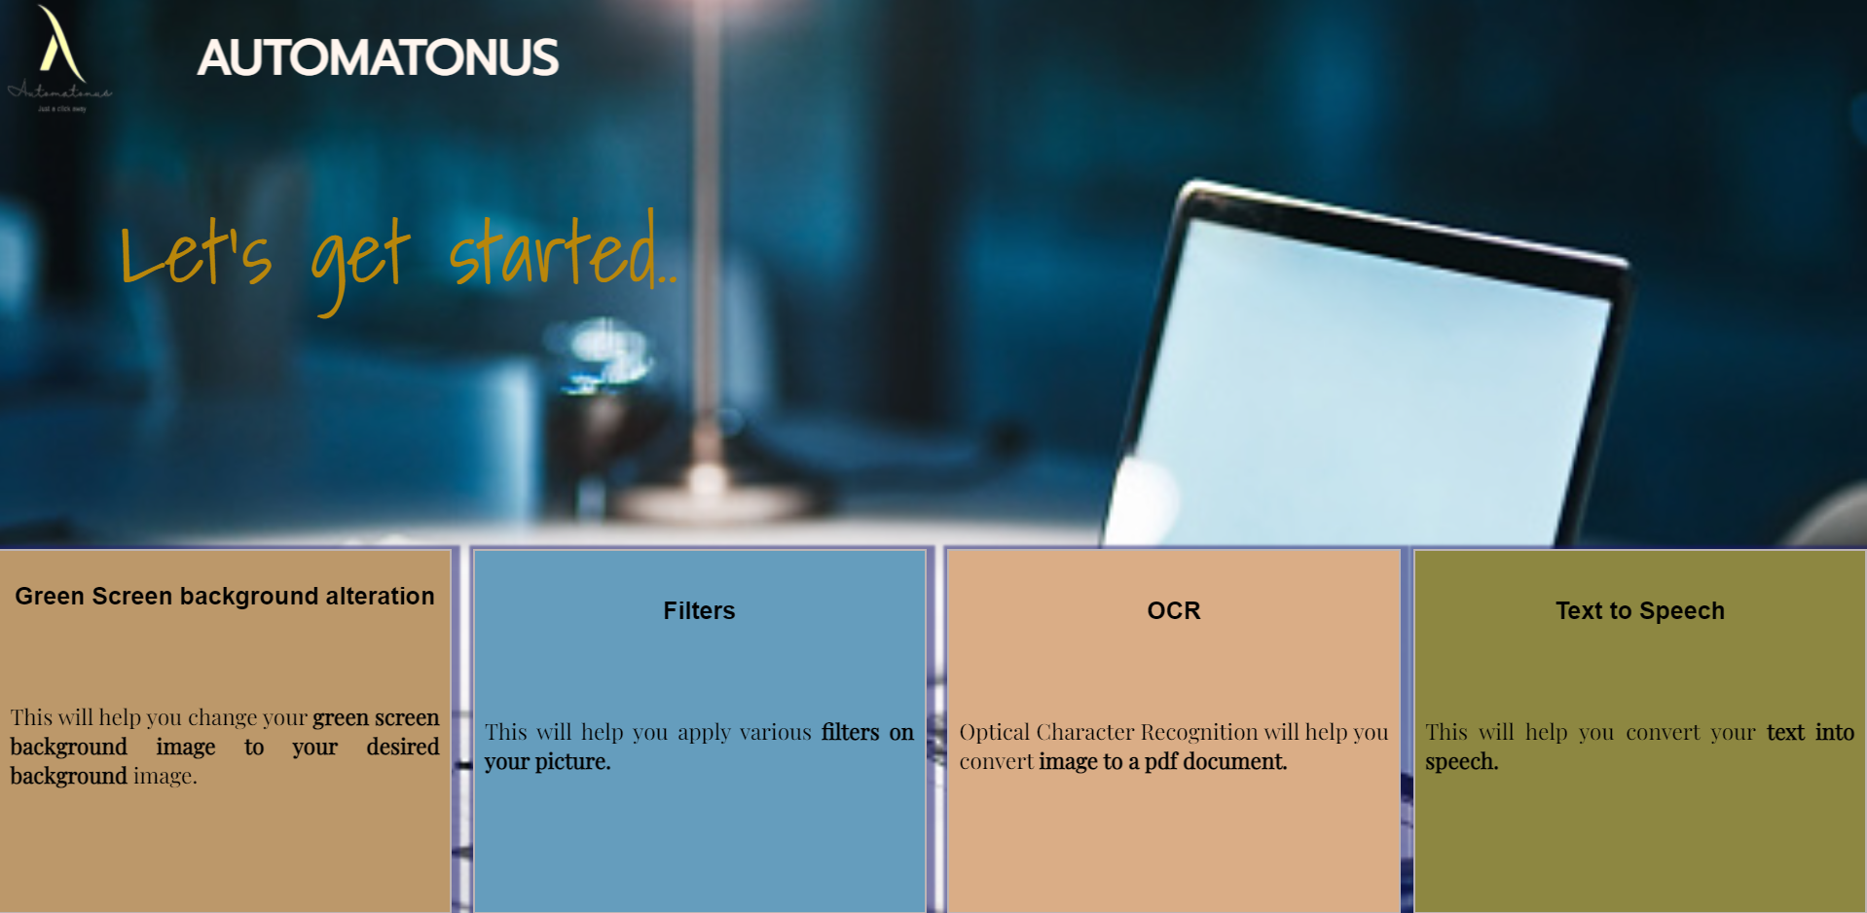
5. Main Page
This is the main page of the website. From this page we can navigate to the four options given below:

Slide 14
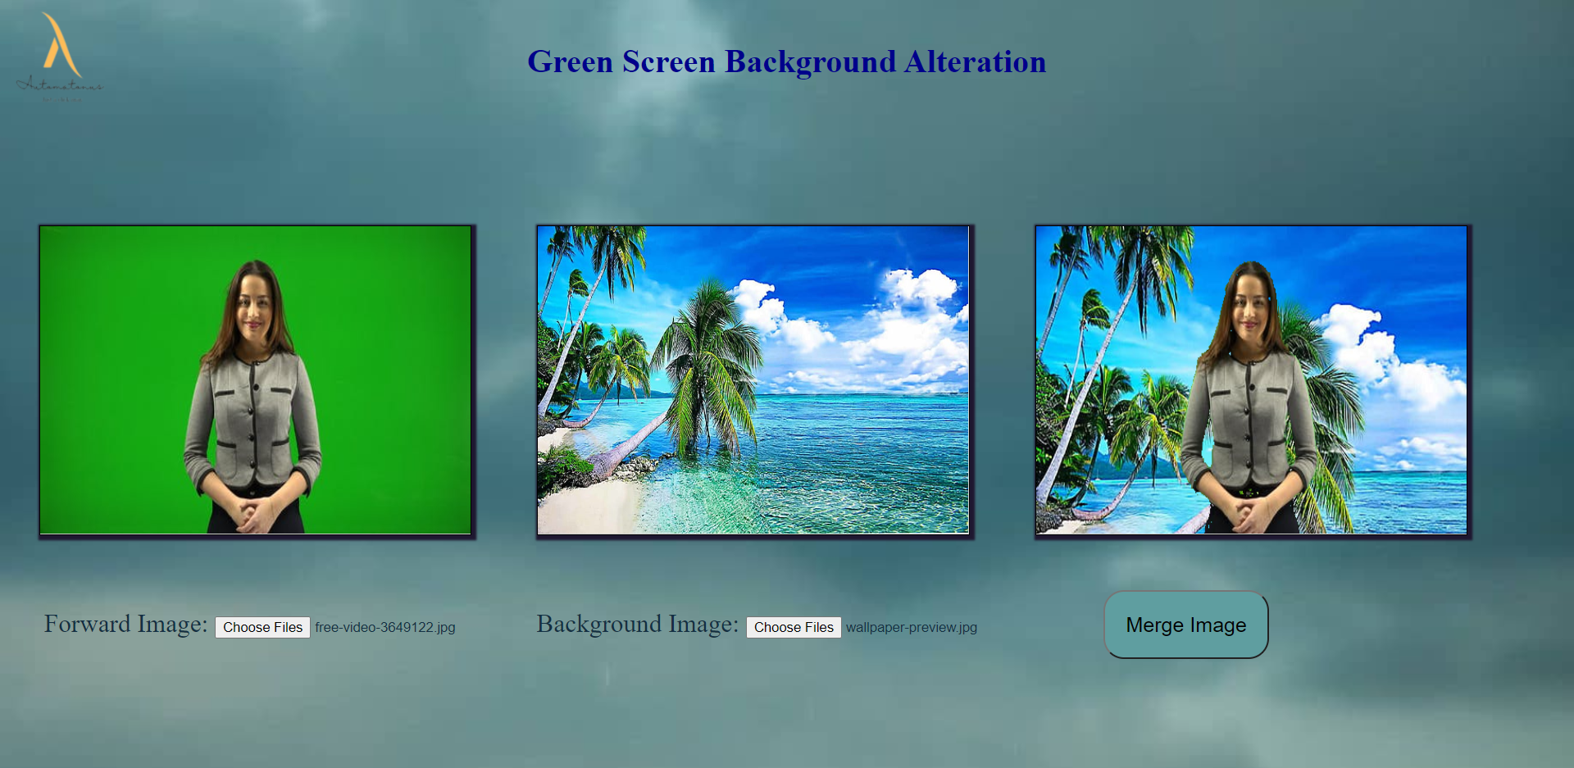
6. Green Screen Background Alteration
In this page, we can take foreground image with green background and any background image and as a result the image gets merged.

Slide 15
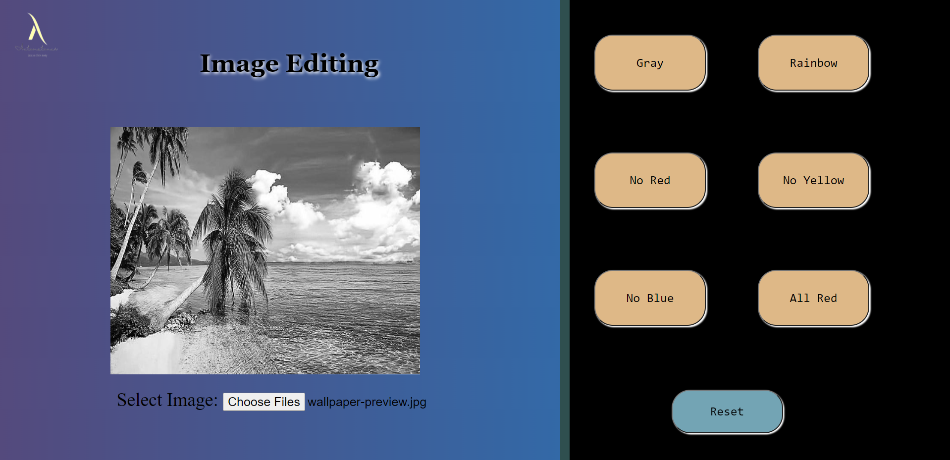
7. Filters
On this page, we can apply various filters on the selected image. As per the filters the image color gets altered.

Slide 16
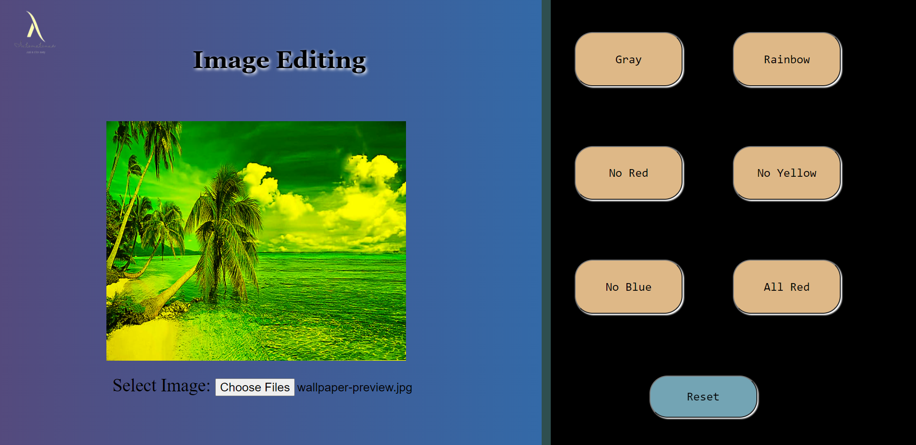
8. Another Filter

Slide 17
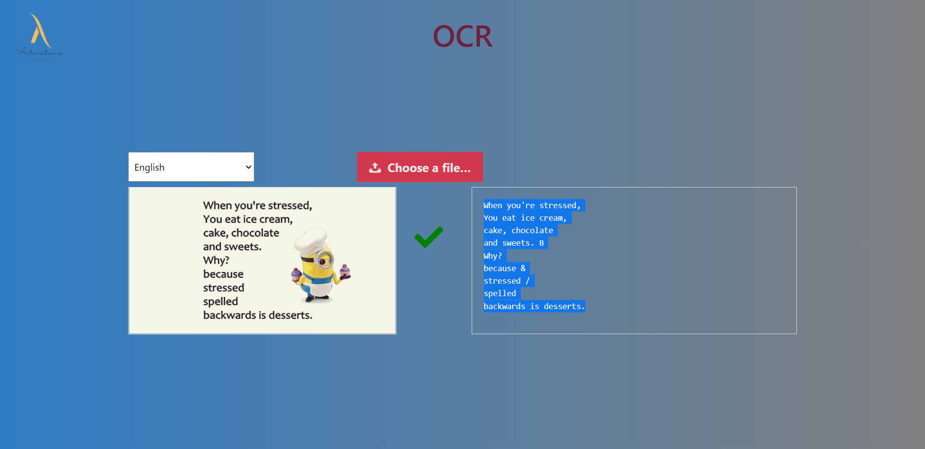
9. Optical Character Recognition(OCR)
This page contains OCR on which we can choose image and the text written on it gets converted in textual form which can be copied and use anywhere you want.

Slide 18
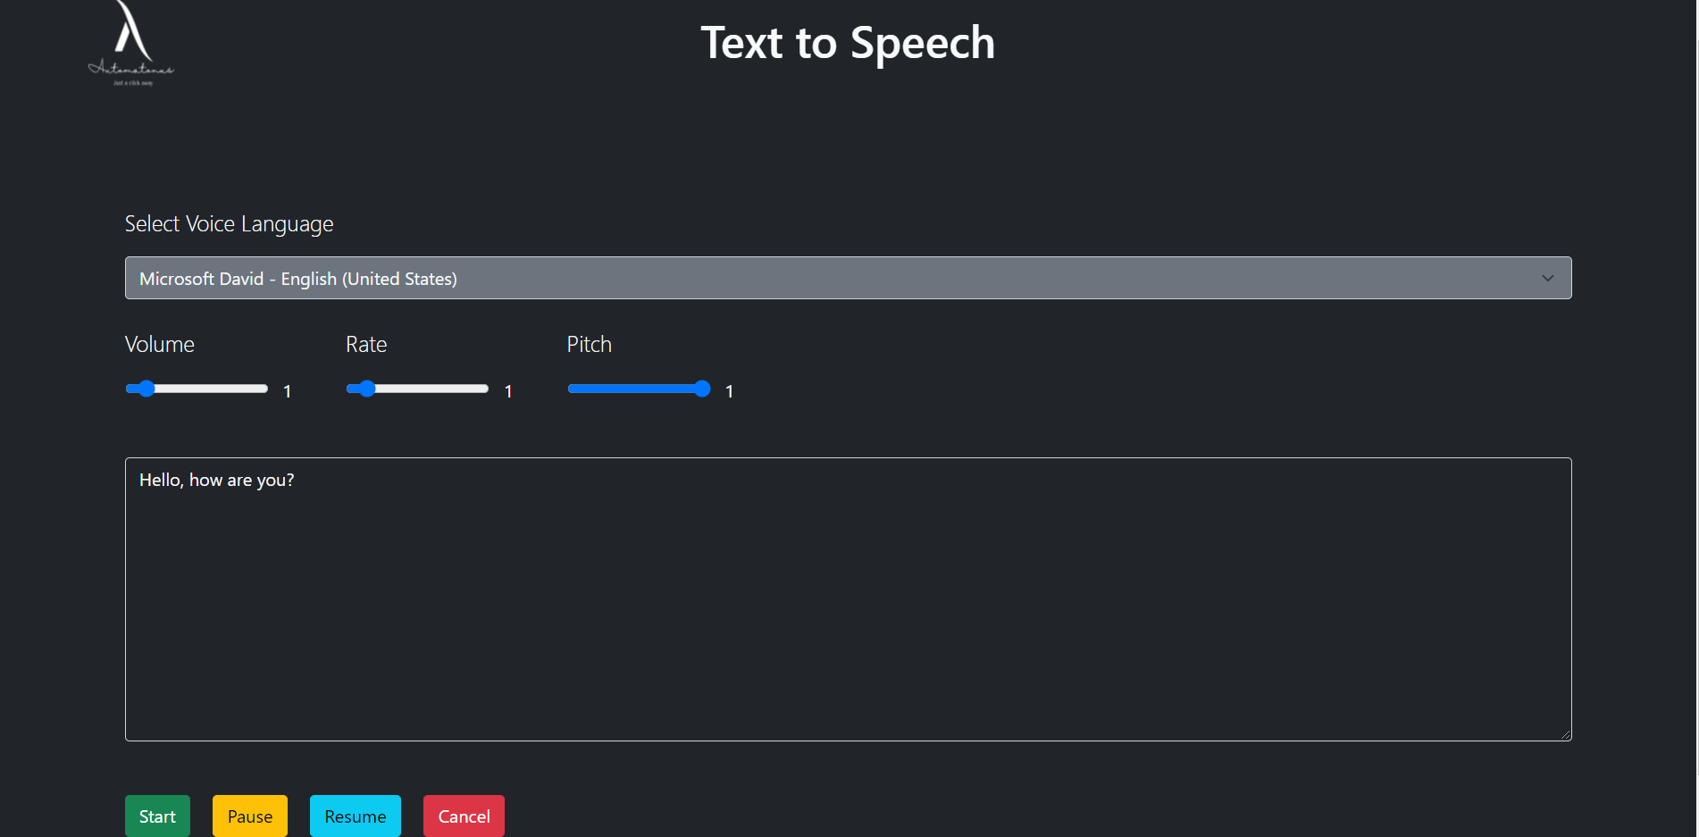
10. Text-to-Speech
Lastly, we have Text-to-Speech, in which the text written in the textbox gets converted into speech. We can also alter the volume, pitch and arte of the speech as per our requirements.

Slide 19
Thank You

